Slide 1

AI and Sexuality
AI System using facial recognition technology to determine sexual orientation

Slide 2
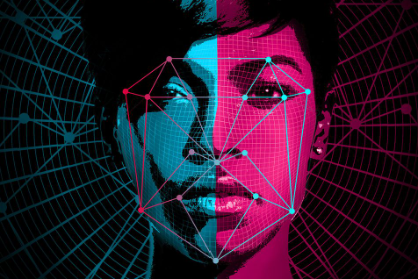
The STUDY
2017 paper from two Stanford Researchers, Yilun Wang and Dr. Michal Kosinski
An AI System was trained to predict sexual orientation only by looking at facial features

Slide 3
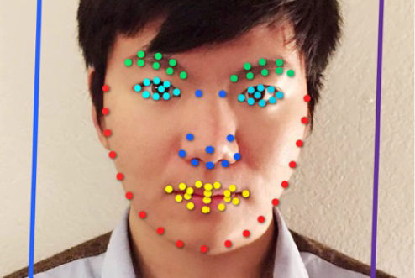
METHEDOLOGY
Data set comprised of 35000+ facial images from a dating website
Training set had equal number of images from heterosexual and homosexual men and women
Sexual orientation was established based on the information provided on the profile
Facial features were extracted from the images using a Deep Neural Network called VGG-Face

Slide 4
RESULTS
Test set contained pairs of one gay and one heterosexual individual
System was able to distinguish between gay and heterosexual men in 81% of cases.
The number for women were a bit lower at 71%
Human judges achieved an accuracy of 61% for men and 54% for women

Slide 5

Authors’ Note
Researchers caution against the misinterpretation of the result
Research’s aim is to make policymakers, the general public, and gay communities aware of the risks that they might be facing already
Support for Prenatal Hormone Theory – exposure to certain hormones can influence the sexual orientation

Slide 6

CRITICISM
Prenatal Hormone Theory! Multiple pathways to a given sexual orientation outcome
Physiognomy - concerns over the emergence of pseudoscience
Lack of diversity in the data pool – white, cis, and caucasian individuals considered

Slide 7
references
Bjork-James, Carwil. “Bad Science Journalism: Gay Facial Recognition.” Carwil without Borders, 9 Sept. 2017, https://woborders.blog/2017/09/09/bad-journalism-gay-facial-recognition/.
Miller, Arianne. “Searching for gaydar: Blind spots in the study of sexual orientation perception.” Psychology & Sexuality, vol.9, issue 3, 29 Apr. 2018, pp.188-203, doi: 10.1080/19419899.2018.1468353
Sandelson, Jessica. “The Politics of AI and Scientific Research on Sexuality.” Engenderings, 19 Mar. 2018, https://blogs.lse.ac.uk/gender/2018/03/19/the-politics-of-ai-and-scientific-research-on-sexuality/.
Science, London School of Economics and Political. “Deep Neural Networks and the Rise of the ‘AI Gaydar.’” London School of Economics and Political Science, https://www.lse.ac.uk/DSI/Research/Blog-posts/Deep-neural-networks-and-the-rise-of-the-'AI-Gaydar'.aspx. Accessed 8 Apr. 2023.
Vasilovsky, A. T. “Aesthetic as genetic: The epistemological violence of gaydar research.” Theory & Psychology, vol. 28, issue 3, 2018, pp. 298–318, doi:10.1177/0959354318764826
Vincent, James. “The Invention of AI ‘Gaydar’ Could Be the Start of Something Much Worse.” The Verge, 21 Sept. 2017, https://www.theverge.com/2017/9/21/16332760/ai-sexuality-gaydar-photo-physiognomy.
Wang, Yilun, and Michal Kosinski. “Deep Neural Networks Are More Accurate than Humans at Detecting Sexual Orientation from Facial Images.” Journal of Personality and Social Psychology, vol. 114, no. 2, 1 Feb. 2018, p. 246. psycnet.apa.org, https://doi.org/10.1037/pspa0000098.

Slide 8

Questions?
Special thanks to Tamiko Eto for the topic

